Slide 1
TEAM ZEEZ HACKMOL IDEA SUBMISSION
Team members: Ram Chockalingam, Varunraaj, Shiva Ramalingam, Surendar.

Slide 2
Problem Statement
As each day passes by there is growing energy demand. Renewable energy sources are rapidly becoming
alternatives to conventional energy sources. Renewable energy sources are the ones that help us reduce harmful emissions of Carbon Dioxide and other greenhouse gases. One of the major concerns while acquiring renewable energy is the constant availability of raw energy from any natural source.
For example, high wind velocities can make wind turbines rotate faster thus damaging the generator and low velocities produce very less power leading to inefficiency of the system. These are the things that cannot be controlled by humans, so it becomes hard to efficiently capture renewable energy at the desired time. Another concern is the effect it has on wildlife where millions of birds die from getting hit by the wind turbine blades, Hydroelectric dams prevent aquatic life to migrate to other places.
Therefore we have to design our renewable energy system such that it somewhat efficiently captures the energy even with weak environmental conditions and at the same time damage occurring due to critical environmental conditions should minimally affect the system. And the land area for the energy system should be wisely used to ease the process of setting the system up. Most importantly the costs of the equipment and maintenance should be minimum. Lastly, it should not affect the lives of other living beings.

Slide 3
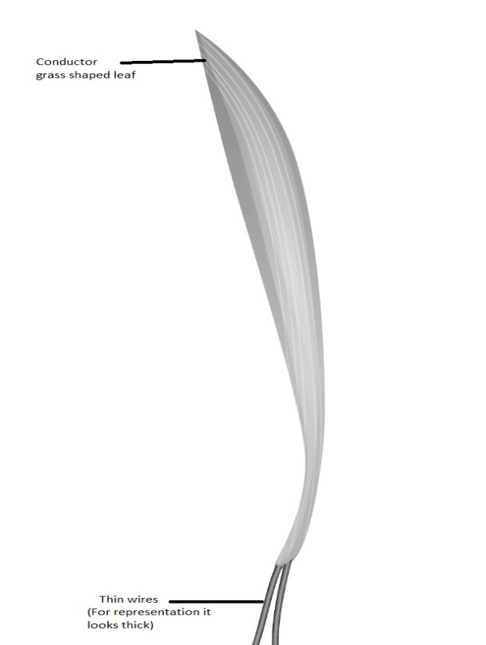
Proposed Solution
Principle:
An EMF is produced when conductive materials cut the flux created by an external magnetic field.
Working Principle:
We use a conductor with a grass shape for cutting the magnetic field which is produced by an electromagnet at each end. (Faraday’s law of electromagnetic induction)
CONCEPT USED : (FARADAY’S LAW OF ELECTROMAGNETIC INDUCTION)

Slide 4
There is a building that consists of many grass-shaped conductors placed close to each other in some span of area, many such floors consist of these grass-shaped conductors.
The building is open such that it allows for the wind to enter and move the grass-like conductors placed on the ground of each floor.
To make sure that we get output only from required wind speeds we place a wind speed sensor on the ceiling of each floor.
The above step is done to make sure that the input energy supplied is lesser than obtained output energy.
In the grass-like conductors due to its movement(by wind), the presence of an external magnetic field produced by the electromagnet and change in the area of the conductors that is cut by the flux there is an accumulation of opposite charges at either end of the conductors thus leading to the formation of an emf across the two ends.
This emf stimulates a current flow from one end to the other according to the polarity of the ends.
Each and every grass-like conductor leaf has two very thin wires which are connected to a bridge wave rectifier fabricated on its base to make the varying positive and negative voltages produced by each conductor leaf to only positive fluctuating wave.
Each of the leaf outputs is connected in series and the final output from all the leaves is stored in a battery.

Slide 5

N
Wind Sensor
Wind Sensor
Base
S
N
Wind Sensor
Wind Sensor
Base
S

Slide 6
It is apparent that technology has the potential to harm or enhance our social skills and social life. The key is to analyze how technology affects us socially. Every technology has its impact on society, be it in a positive or negative manner. But it is the responsibility of society to use technology in view of sustainable development.

Slide 7
THANK YOU

